Slide 1

Testing And Verifying Agile Project
Present by: Group 3

Slide 2







Team Member
Chun Phally
Nanh Bunsin
Theng Vanthoeurn
Thai Vannet
Khon Koeung
Leng Chhay Laing

Slide 3
Content
Introduction
Testing practices in Agile development
Agile methodologies
Agile testing quadrants
Test first development and test driven development
Behaviour driven development
Acceptance test driven development
Advantages of testing in an Agile environment
Difficulties of testing in an Agile environment
Conclusión
1
2
3
4
5
6
7
8
9
10

Slide 4
Introduction
As software development continues to evolve, the size and complexity of software systems have increased dramatically. This poses significant challenges, especially when it comes to the testing and quality assurance of these complex systems.
In the past, software development models like Waterfall, Spiral, and V-model were used, where testing was often a separate phase conducted after the main coding work. However, the emergence of the Agile Manifesto in 2001 brought a fundamental shift in the way software is developed and tested.
This presentation will explore the Agile approach to software testing, examining the key practices, methods, advantages, and challenges of Agile testing. We will dive into the Agile Testing Quadrants, various Agile testing methodologies, and how they differ from traditional testing approaches.
Présenter: Vanthoeurn

Slide 5
2. Testing practices in agile development
Testing practices in Agile software development refer to the various methods, techniques, and approaches used to ensure the quality and reliability of the software being developed. In an Agile environment, testing is integrated throughout the development lifecycle, rather than being a separate phase as in traditional development models.
Présenter: Vanthoeurn

Slide 6
3. Agile methodologies
Agile methodologies refer to a project management framework that divides projects into manageable phases known as sprints. This approach focuses on continuous collaboration, improvement, and flexibility to adapt to changing needs throughout the project lifecycle.
There are some keys methodologies in Agile testing:
Acceptance test driven development
Testing Quadrant
Agile methodologies
First development
& driven development
Behaviour driven development
Présenter: Chhay Laing

Slide 7
4. Agile testing quadrants
Agile testing can be divided into four main sections that represent different ways and motivations to test in Agile development. The four sections are usually visualised as a diagram with four quadrants. Each of these quadrants has a role in the Agile testing process.
Quadrant 1
Automated
Quadrant 2
Automatic & Manual
01
02
Quadrant 3 Manual
03
04
Quadrant 4 Tools
Présenter: Chhay Laing

Slide 8
4. Agile testing quadrants
Chun Phally
Quadrant 1 (Automated)
Technology tests that support the development team in building the foundation of software design and development.
Ensures the developer team's code is functioning correctly before it's integrated and published to customers.
Unit and component testing help validate the small parts of the code without interference from other parts of the system.
Roles:
Developers primarily perform these tests, but they can also be automated.
Component testing is often done in a black-box manner, where the tester does not need to understand the internal architecture.
Présenter: Chhay Laing

Slide 9
4. Agile testing quadrants
Quadrant 2 (Automated & Manual)
1
Component Test
Unit Test
Verify the functionality of individual components or methods of the code.The goal of unit testing is to catch bugs early in the development process and to speed up testing strategies by focusing on small, manageable pieces of code
Focus on the general design of a specific part of the software, including the behavior between the classes or their methods. it is often done in a black-box manner, where the tester does not need to understand the internal architecture
Présenter: Chhay Laing

Slide 10
4. Agile testing quadrants
Quadrant 2 (Automated & Manual)
Business and customer-side testing aimed at improving the quality of the software to meet customer needs and requirements.
Ensure the software’s functionality meets user expectations and requirements.
Tests are designed to be understandable by people who may not know how to code, enhancing usability and accessibility.
Helps identify and fix potential problems quickly through automated tests and continuous integration.
Roles:
Testers, developers, and business analysts collaborate to create and execute tests.
Functional tests can be black-box tests, where testers do not need to understand the underlying code.
Présenter: Phally

Slide 11
4. Agile testing quadrants
Quadrant 2 (Automated & Manual)
Test the overall functionality of the software.
Functional Tests
These tests validate that the functionality described in a user story has been correctly implemented and meets the acceptance criteria defined by the product owner or customer.
Story Tests
03
Test user interfaces through mock-ups and prototype models.
Prototypes
Présenter: Phally

Slide 12
4. Agile testing quadrants
Quadrant 3 (Manual)
Business-side testing with an emphasis on ensuring the product aligns with customer needs and expectations.
Identify misunderstandings, missing functionalities, and usability issues.
Simulate real-world use cases to validate the product’s functionality and user experience.
Roles:
Involves testers, customers, and end-users to validate the software in real-world situations.
Tests may be conducted by the development team, customers, or end-users.
Présenter: Phally

Slide 13
4. Agile testing quadrants
Quadrant 3 (Manual)
03
01
Usability Testing
04
Exploratory Testing
02
Testers actively explore the software to identify defects and issues. Findings are documented during or after the testing session.
Scenario Testing
Assesses the user interface and user experience. And report with sanity test case.
User Acceptance (UAT)
The final phase of testing before the product goes live, conducted by the end-users or clients to ensure that the software meets their requirement.
Tests based on real-world scenarios to validate the software. Scenarios are executed to see how the application performs under various conditions
Présenter: Phally

Slide 14
4. Agile testing quadrants
Quadrant 4 (Tools)
Performance and load testing to ensure the software can handle real-world conditions.
Identify performance bottlenecks and scalability issues.
Ensure the software can handle high load and stress conditions without performance degradation.
Roles:
Typically performed by specialized testers or performance engineers.
Uses tools and techniques to simulate real-world load and stress conditions.
Présenter: Phally

Slide 15
4. Agile testing quadrants
Quadrant 4 (Tools)
01
Identifies vulnerabilities in the system to protect against security threats like unauthorized access, data breaches, and other malicious activities. Includes penetration testing, vulnerability scanning, and risk assessment.
Security
02
How the application performs under expected and peak load conditions. It helps identify bottlenecks and ensures that the system can handle the required number of users or transactions.
Performance Testing
03
Stress Testing
Determines the software's behavior under extreme conditions or high stress.
Présenter: Phally

Slide 16
5. Test first development and Test driven development
Test First development
TFD focuses on test preparation the tests are done before the actual coding takes place.The tests are made when a story is developed by team members skillful in analysis, designing, building, and testing.Sometimes the customer can be involved in the test creation process to give them some assure them that their criteria are met.
Test driven development
Test Driven Development (TDD) has the same priorities as (TFD).TDD is main focus is the automated unit and component testing in testing quadrant 1.The automated tests provide better guidelines for the development team to provide quality products.
Présenter: Koeung

Slide 17
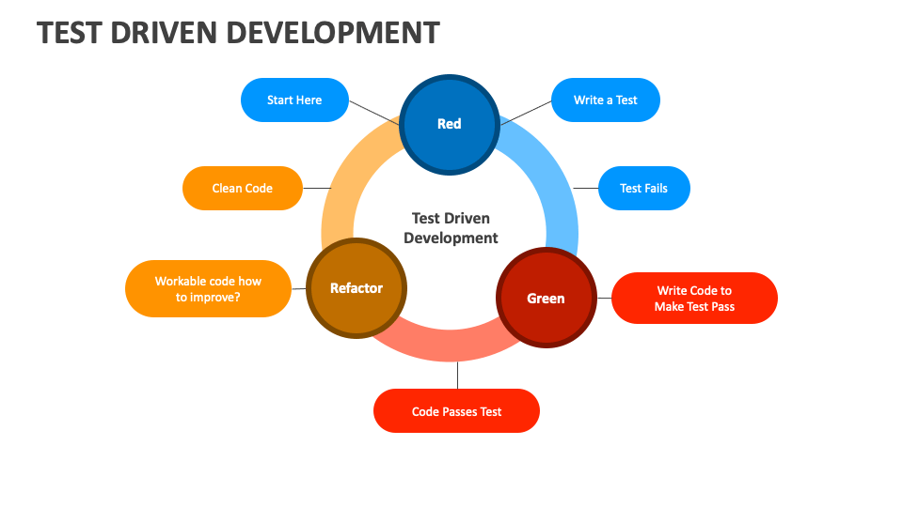
6. Behaviour Driven Development
Behavior-driven development (BDD) is an Agile software development methodology in which an application is documented and designed around the behavior a user expects to experience when interacting with it. A typical project using behavior-driven development would begin with a conversation between the developers, managers and product owner to form an overall picture of how a product is intended to work.
Présenter: Koeung

Slide 18
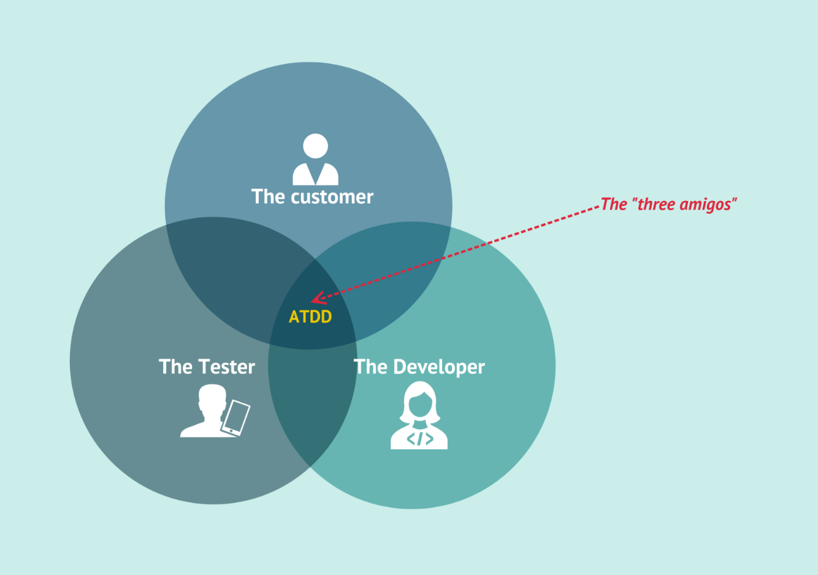
7. Acceptance Test Driven Development
Acceptance test-driven development (ATDD) is a collaborative process where developers, testers and product owner come together to work out requirements, perceive potential pitfalls and reduce the chance of errors before coding begins.
Présenter: Koeung

Slide 19
8. Advantages of testing in an Agile environment
Improved communication and flexibility: Agile testing fosters better communication between testers and developers, reducing the need for extensive documentation. This allows teams to adapt to changes quickly and choose the most suitable testing methods for their project.
Reduced technical debt: By following Agile testing practices, teams can effectively minimize technical debt. This includes writing clean and maintainable code, performing automated unit tests, and using load testing to identify potential issues early on.
Faster and more efficient testing: Agile testing emphasizes early and continuous testing throughout the development cycle. This collaborative approach between developers and testers leads to faster detection and fixing of bugs, reducing overall testing time and cost.
Présenter: Bunsin

Slide 20
9. Difficulties of testing in an Agile environment
9.1 Need for Experienced Teams
Undefined Testing Practices
Trial and Error
Role of Coaches
Agile does not prescribe strict testing methods, requiring teams to innovate and adapt through trial and error.
Can lead to wasted effort and delays.
Hiring experienced Agile coaches can expedite team learning and efficiency but can be expensive.
Présenter: Vannet

Slide 21
9. Difficulties of testing in an Agile environment
9.2 Communication Challenges
Critical Nature
Flexible Requirements
Team Dynamics
Clear communication is essential to avoid misunderstandings that lead to incorrect testing.
Agile's evolving nature means requirements often change, making previous tests potentially obsolete.
Effective communication tools and practices are necessary to keep everyone aligned.
Présenter: Vannet

Slide 22
9. Difficulties of testing in an Agile environment
9.3 High Effort and Collaboration
Close Tester-Developer Collaboration
Impact on Workflow
User Acceptance Testing (UAT)
Agile requires seamless collaboration for quick identification and resolution of bugs.
Quick bug fixing can temporarily halt project progress.
Demands significant resources for setup, analysis, and conclusion drawing from user behavior.
Présenter: Vannet

Slide 23
9. Difficulties of testing in an Agile environment
9.4 Lack of Documentation
Documentation Gaps
Knowledge Transfer
Maintenance Challenges
Agile projects often lack detailed documentation, complicating the onboarding of new team members.
Difficulty in understanding past testing efforts hinders knowledge transfer and project continuity.
Lack of documentation can make long-term maintenance and updates more complex.
Présenter: Vannet

Slide 24
10. Conclusión
10.1 Benefits of Agile Testing
Enhanced Software Quality
User Experience
Maintainability and Performance
Continuous testing ensures higher quality output.
Frequent feedback loops improve user satisfaction and product usability.
Regular testing helps maintain performance standards and simplifies future maintenance.
Présenter: Vannet

Slide 25
10. Conclusión
10.2 Faster Product Delivery
Efficient Processes
Continuous Testing
Customer Involvement
Agile methodologies streamline development and testing processes, leading to quicker releases.
Integrating testing into every development phase ensures issues are caught early.
Regular customer feedback helps refine requirements and align product development with user needs.
Présenter: Vannet

Slide 26
10. Conclusión
10.3 Challenges and Requirements
Experienced Teams
High Individual Effort
Effective Communication
Documentation Solutions
The success of Agile testing heavily relies on the team's experience and expertise.
The success of Agile testing heavily relies on the team's experience and expertise.
The success of Agile testing heavily relies on the team's experience and expertise.
The success of Agile testing heavily relies on the team's experience and expertise.
Présenter: Vannet

Slide 27

Any questions
Response by: Group 3

